Slide 1
UK Productivity Analysis
Project by KangHin Lee
D-12 Data Analyst Course
16th March 2022

Slide 2
1. Introduction

Slide 3


What is Productivity
$$Productivity= \frac{Labour Output}{Labour Input}$$
$$Growth rate=rate of change in productivity per year$$
Notes:
Productivity is an economic concept for measuring labour efficiency, given by the output volume per labour input. A high productivity can leads to an increasing profitability of the company/country. Meaning we can either produce higher output with the same amount of work, or produce the same output with less labour required.
Productivity can be measured different ways, and for this analysis we will only be using output per hour worked as our definitions of productivity.
The Growth rate is the rate of change in productivity. It measures the performance of the industry

Slide 4
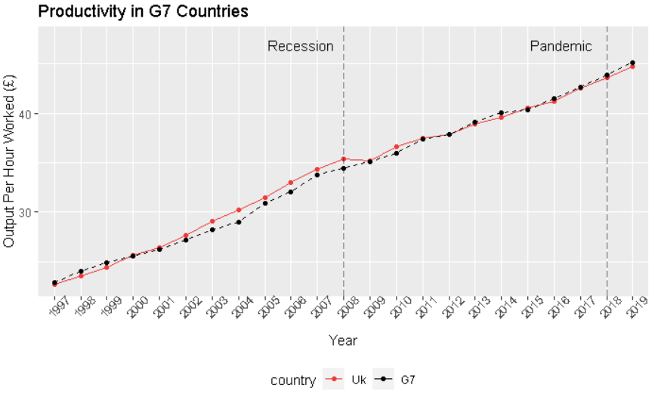
Productivity between UK & G7 Countries
Notes:
Since 2000 the UK’s productivity is always higher than the G7 countries until the great recession in 2008. Since then, the UK’s productivity has been declining to a point where the productivity is lower than the G7 average.

Slide 5
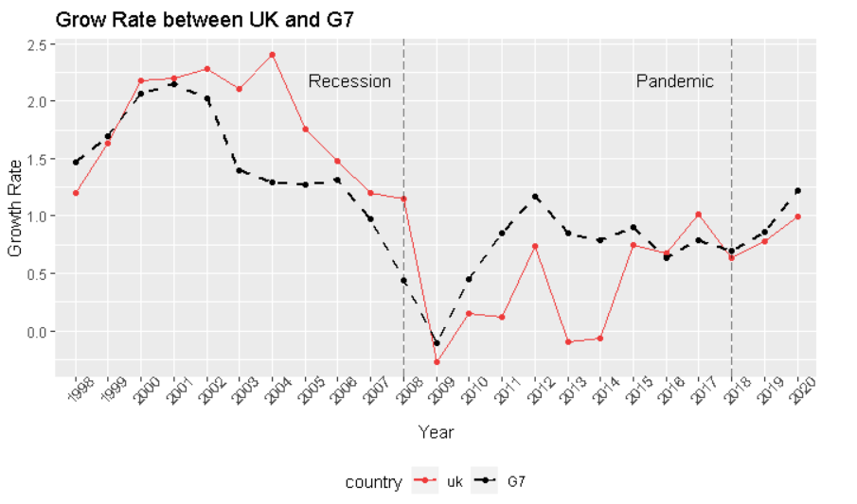
Grow Rate between UK vs G7
Notes:
This decline characteristics can be seen in the growth rate graph. After the sharp drop in 2008, we can see the G7’s growth rate has rose rapidly to level off the impact left from the recession, whereas UK’s growth rate remained relatively low that led to an underperform period.
This is the initiative for this project that we need to find ways to boost productivity and increase UK’s competitiveness against the global market.

Slide 6
Aim of the Project
Business Question:
How can we improve productivity within Scotland and the UK overall?
MVP:
Which industries are lagging behind in terms of productivity?
What factors can be improved to increase employee productivity across UK regions?

Slide 7
2. Productivity Growth Per Industry
Notes:
The first part of this analysiwe will be comparing how different industries perform.

Slide 8
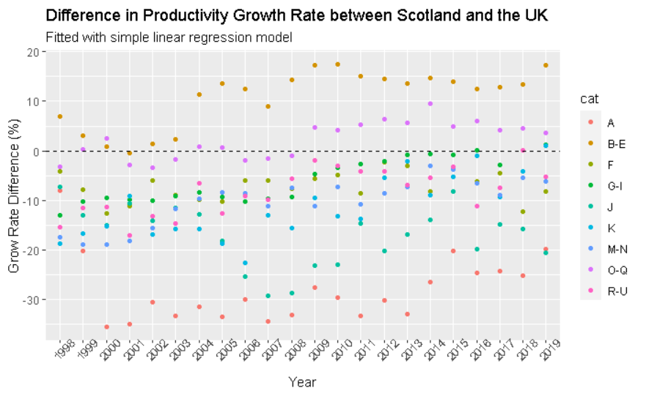
Methodology
SIC | Group Name
A | Primary Product
B-E | Engineering
F | Civil Construction
G-I | Tertiary product
J | Information and communication
K | Finance
M-N | Academic Research
Notes:
The industries are grouped by standard industrial classification.
The performance indicator that was is used is the difference in growth rate between Scotland and the UK.
It indicates Scottish industries performance relative to its UK counterparts. If the data point is above 0 it means Scottish industries perform better than rest of the UK and vice versa.
A validated linear regression model was deployed to observe the over trend of performance through the years.

Slide 9
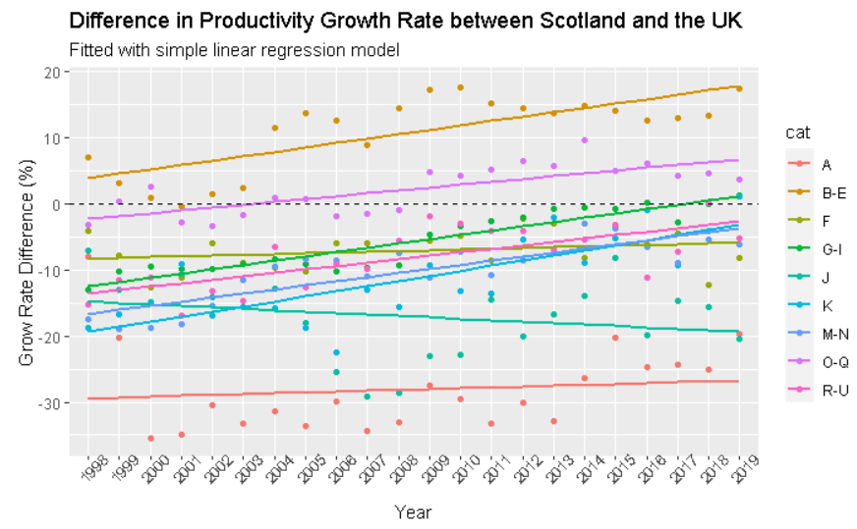
Methodology
SIC | Group Name
A | Primary Product
B-E | Engineering
F | Civil Construction
G-I | Tertiary product
J | Information and communication
K | Finance
M-N | Academic Research
Notes:
The industries are grouped by standard industrial classification.
The performance indicator that was is used is the difference in growth rate between Scotland and the UK.
It indicates Scottish industries performance relative to its UK counterparts. If the data point is above 0 it means Scottish industries perform better than rest of the UK and vice versa.
A validated linear regression model was deployed to observe the over trend of performance through the years.

Slide 10
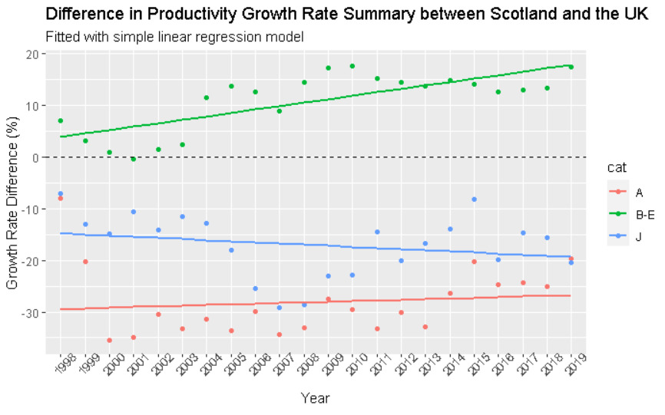
Productivity Growth Per Industry Scotland vs. UK
SIC | Category Name
A | Primary Product
B-E | Engineering
J | Information and communication
Notes:
The best performed Scottish industry is engineering in green, with the data points laying above the margin with a positive trend, indicating the industry is always growing faster when compared to the rest of the UK with a strong growth throughout the year.
Primary Product Industry in red, has the highest negative margin, meaning the productivity growth is always slower than it’s UK counterparts, however, the positive trend indicated the industry is slowly catching up.
The last highlight is Information and communication industry in blue, it has the second highest negative margin with a down trend, indicating the productivity growth rate is always slower when compared than the rest of the UK and performance is continuously declining throughout the year.
A similar analysis was carried out comparing UK and G7 countries. However, stat showed that the analysis was insignificant with an irrelevant relationship between the regression and the data point itself. Therefore I won’t be presenting the result in this presentation.

Slide 11
3. Productivity Factors
Notes:
The second part of the analysis is aimed to find out which economic factors have influence on productivity, through conducting a series of hypothesis tests.

Slide 12
Methodology
Hypothesis Test:
2 Samples Independent tests
5% Confidence Level
Test against OECD countries using UK as a reference index
Economic Factors:
Inflation rate
Annual hours worked
Average / Minimum salary
Education proportion per population:-
Below Upper Secondary
Upper Secondary
Tertiary
Notes:
The economic factors are listed on the right, included inflation rate, annual hours worked, average / minimum salary along with 3 levels of education proportion per population
We have adapted 2 samples independent test, 5% confidence level.
We will be using Organisation for Economic Cooperation and Development countries (OECD) countries for the tests and UK as a reference index.
(i.e. On average, does a country with a higher salary than the UK, have a significant difference in productivity.)

Slide 13
Hypothesis Test Results
Hypothesis Test Factors | Influence on Productivity
Higher Inflation Rate | Significantly Lower
Higher Worked Hours | Significantly Lower
Higher Min/Average Salary | Significantly Higher
Upper Secondary Education | Significantly Higher
Below Upper Secondary Education | Insignificant
Tertiary Education | Insignificant
Notes:
On average, productivity is significantly lower with a higher inflation rate.
With a higher worked hours, including over time, deem as an inefficient way to produce output, resulted a significantly lower productivity.
Increase in minimum or average salary to boost the workers’ morale will have a significantly higher productivity.
For the 3 levels of Education proportion, only an increase in proportion of upper secondary education results in a significantly higher productivity, the 2 remained levels are deemed to be insignificant.

Slide 14
Conclusion
How can we improve productivity within Scotland and the UK overall...
1. Which industries are lagging behind in terms of productivity?
Scottish Primary Product Industry
Scottish Information and Communication Industry
2. What factors can be improved to increase employee and/or business productivity across UK regions?
On average, countries with higher Minimum / Average salary and Upper Secondary Education have significantly higher productivity.
Notes:
After the great recession in 2008, the productivity growth in the UK has been slowed down resulted in a lower productivity when compared with G7 average.
In the industry productivity analysis. We have found that Scottish’s engineering industry performed the best among the others, with a strong increase in growth rate.
The Primary product industry is the most lagging behind industry in terms of the growth rate difference, however, evidence showed the positive trend indicates the growth rate is slowly improving throughout the year.
The Scottish Information and Communication Industry is the second lagging behind industry, with a downtrend indicating the growth rate is continuously declining throughout the year.
A series of hypothesis tests are conducted with different economics factors.
On average, higher min/avg salary and higher proportion of secondary education will result in significantly higher productivity.
With higher worked hours and inflation rate will result in a significantly lower productivity.

Slide 15
The End

Slide 17
Hypothesis Test Results
Hypothesis Test Factors | Results | Impact on Productivity
Higher Unemployment Rate | Significant | Negative
Higher Inflation Rate | Significant | Negative
Higher Worked Hours | Significant | Negative
Higher Min/Average Salary | Significant | Positive
Upper Secondary Education | Significant | Positive
Below Upper Secondary Education | Insignificant | --
Tertiary Education | Insignificant | --
Notes:
The results showed that times with a
On average, the productivity of countries with higher unemployment and inflation rate are significantly lower than countries with lower unemployment rate.
With a higher worked hours, including over time, resulted a significantly lower productivity.
To boost the works’ morale
Decouple Analysis and Confounding factors
The concluded drawn from the decoupled analysis for this project are for guidance only.
Interaction & cofounding factors are not taking into account but may affect to the labour’s productivity.
Higher min/avg wage, higher secondary education will have a high stat significant influence on the productivity.
Higher worked hours, unemployment rate and inflation rate will have a lower stat-significant influence on the productivity.

Slide 18
Industry Catagory
SIC Code | Category Name | Industries
A | Primary Product | Agriculture, forestry and fishing
B-E | Engineering | Industry (except construction)
F | Civil Construction | Construction / Civil Industry
G-I | Tertiary product | Wholesale and retail trade, transport, accommodation and food service activities
J | Information and communication | Information and communication
K | Finance | Financial and insurance activities
M-N | Academic | Professional, scientific and technical activities; administrative and support service activities

